Slide 1
Eclipse Plug-in Development
SWT/JFace Development Part 4
Viewers

Slide 2
Contents
Introducing the JFace Viewers
Viewers in JFace
ComboViewer
ListViewer
TableViewer
Filter
Cell Editor
TreeViewer
Filter
Cell Editor

Slide 3
Viewers
Content provider
IStructuredContentProvider
List elements of domain
Controls
List
Combo
Table
ArrayContentProvider
Array
Collection
ITreeContentProvider
List children
Determine parent
Tree

Slide 4
Viewers
Label provider
ILabelProvider
Used for Lists and Trees
Defines icon and label for each element
CellLabelProvider
Used for Tables
Defines a label provider per column
ITableLabelProvider
Used for Tables
Provide the text and/or image for each column of a given element

Slide 5
Viewers
Input
Domain model
Null to clear contents

Slide 6
Viewer
Creating a Viewer
Initialize
Set content provider
Set label provider
Set input
Manage Selections
ISelectionChangeListener
IStructuredSelection
Set selection and reveal

Slide 7
Viewers
Custom a Viewer
create SWT controls for viewer (in constructor) (optional)
initialize SWT controls from input (inputChanged)
define viewer-specific update methods
support selections (setSelection, getSelection)

Slide 8
ComboViewer
Initialize
Default
With Combo or CCombo control
ComboViewer viewer1 = new ComboViewer(parent, SWT.READ_ONLY);
CCombo ccombo = new CCombo(parent, SWT.READ_ONLY);
ComboViewer viewer2 = new ComboViewer(ccombo);
Combo combo = new Combo(parent, SWT.READ_ONLY);
ComboViewer viewer3 = new ComboViewer(combo);

Slide 9
ListViewer
Initialize
Default
With List control
ListViewer viewer1 = new ListViewer(parent);
ListViewer viewer2 = new ListViewer(parent, SWT.MULTI | SWT.BORDER);
List list = new List(parent, SWT.MULTI | SWT.BORDER);
ListViewer viewer3 = new ListViewer(list);

Slide 10
TableViewer
Initialize
Default
With Table control
TableViewer viewer1 = new TableViewer(parent);
TableViewer viewer2 = new TableViewer(parent, SWT.FULL_SELECTION|SWT.BORDER);
Table table = new Table(parent, SWT.FULL_SELECTION|SWT.BORDER);
TableViewer viewer3 = new TableViewer(table);

Slide 11
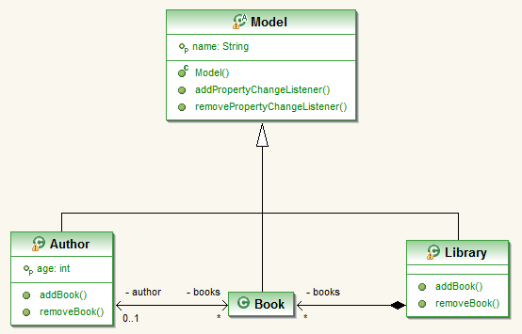
Table Viewer
Domain model
Try to list all books for a library
Library library = new Library("Center Public Library");
library.addBook(new Book("Children Education, 3-6 years old",
new Author("Ben Jermain", 34)));
library.addBook(new Book("Children Education, 6-12 years old",
new Author("Ben Jermain", 34)));
library.addBook(new Book("Baby Names Book", new Author("Quan Jia", 56)));
library.addBook(new Book("Java Development", new Author("Van Jondon",
43)));

Slide 12
Table Viewer
Content Provider
private static class MyContentProvicer1 implements
IStructuredContentProvider {
public void dispose() {
}
public void inputChanged(Viewer viewer, Object oldInput, Object newInput) {
}
public Object[] getElements(Object inputElement) {
if (inputElement instanceof Library) {
return ((Library) inputElement).getBooks().toArray();
}
return new Object[0];
}
}

Slide 13
Table Viewer
Label provider
private static class MyLabelProvider1 extends LabelProvider {
public String getText(Object element) {
if (element instanceof Model) {
return ((Model) element).getName();
}
return super.getText(element);
}
}

Slide 14
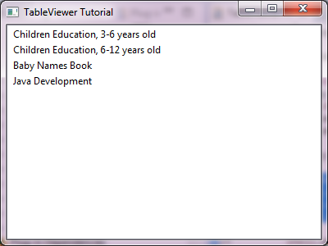
Table Viewer
Set Input
TableViewer viewer = new TableViewer(shell);
viewer.setContentProvider(new MyContentProvicer1());
viewer.setLabelProvider(new MyLabelProvider1());
viewer.setInput(library);

Slide 15
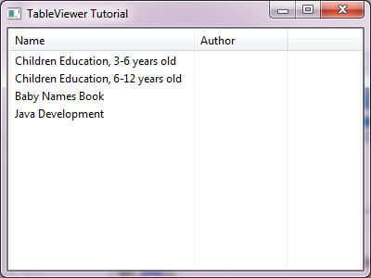
Table Viewer
Add columns
viewer.getTable().setHeaderVisible(true);
TableViewerColumn nameColumn = new TableViewerColumn(viewer, SWT.NONE);
nameColumn.getColumn().setText("Name");
nameColumn.getColumn().setWidth(200);
TableViewerColumn authorColumn = new TableViewerColumn(viewer, SWT.NONE);
authorColumn.getColumn().setText("Author");
authorColumn.getColumn().setWidth(100);

Slide 16
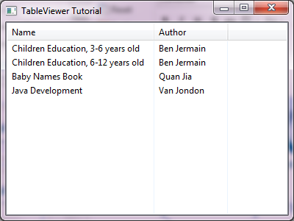
Table Viewer
Update label provider for Author column
private static class MyLabelProvider2 extends LabelProvider implements
ITableLabelProvider {
public Image getColumnImage(Object element, int columnIndex) {
return null;
}
public String getColumnText(Object element, int columnIndex) {
if (element instanceof Book) {
if (columnIndex == 0) {
return ((Book) element).getName();
} else if (columnIndex == 1) {
Author author = ((Book) element).getAuthor();
if (author != null) {
return author.getName();
}
}
}
return null;
}
}
}

Slide 17
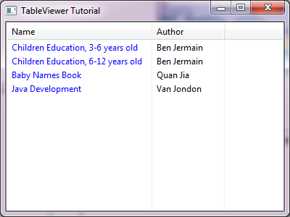
Table Viewer
CellLableProvider
ColumnLabelProvider
nameColumn.setLabelProvider(new ColumnLabelProvider() {
public String getText(Object element) {
if (element instanceof Book) {
return ((Book) element).getName();
}
return super.getText(element);
}
public Color getForeground(Object element) {
return display.getSystemColor(SWT.COLOR_BLUE);
}
});

Slide 18
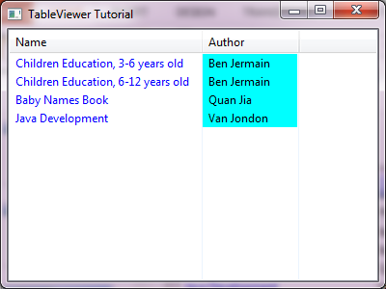
Table Viewer
CellLabelProvider
ColumnLabelProvider
authorColumn.setLabelProvider(new ColumnLabelProvider() {
public String getText(Object element) {
if (element instanceof Book) {
Author author = ((Book) element).getAuthor();
if (author != null) {
return author.getName();
}
}
return super.getText(element);
}
public Color getBackground(Object element) {
return display.getSystemColor(SWT.COLOR_CYAN);
}
});

Slide 19
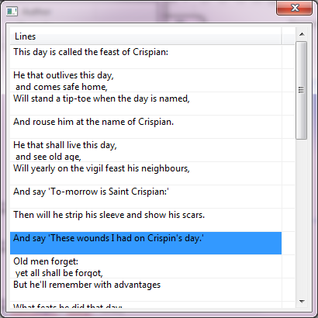
Table Viewer
CellLabelProvider
OwnerDrawLabelProvider
viewer.setLabelProvider(new OwnerDrawLabelProvider() {
protected void measure(Event event, Object element) {
LineEntry line = (LineEntry) element;
Point size = event.gc.textExtent(line.line);
event.width = viewer.getTable().getColumn(event.index).getWidth();
int lines = size.x / event.width + 1;
event.height = size.y * lines;
}
protected void paint(Event event, Object element) {
LineEntry entry = (LineEntry) element;
event.gc.drawText(entry.line, event.x, event.y, true);
}
});

Slide 20
Table Viewer
Cell Editor
viewer.setColumnProperties(COLUMN_PROPERYIES);
viewer.setCellEditors(new CellEditor[] {
new TextCellEditor(viewer.getTable()), null });
viewer.setCellModifier(new ICellModifier() {
…
});
public void modify(Object element, String property, Object value) {
if (COLUMN_PROPERYIES[0].equals(property)) {
if (element instanceof TableItem) {
element = ((TableItem) element).getData();
}
if (element instanceof Book) {
((Book) element).setName(value.toString());
}
}
viewer.update(element, new String[] { property });
}
public Object getValue(Object element, String property) {
if (COLUMN_PROPERYIES[0].equals(property)) {
if (element instanceof Book) {
return ((Book) element).getName();
}
}
return null;
}
public boolean canModify(Object element, String property) {
return COLUMN_PROPERYIES[0].equals(property);
}

Slide 21
Table Viewer
Cell Editor with EditingSupport
SWT.FULL_SELECTION
protected boolean canEdit(Object element) {
return true;
}
protected CellEditor getCellEditor(Object element) {
return new DialogCellEditor(viewer.getTable()) {
protected Object openDialogBox(Control cellEditorWindow) {
InputDialog dialog = new InputDialog(cellEditorWindow
.getShell(), "Author Name",
"Change the name of Author",
(String) getValue(), null);
dialog.open();
return dialog.getValue();
}
};
}
authorColumn.setEditingSupport(new EditingSupport(viewer) {
…
});
protected void setValue(Object element, Object value) {
if (element instanceof Book) {
Author author = ((Book) element).getAuthor();
if (author != null) {
author.setName(value.toString());
}
}
viewer.update(element, null);
}
protected Object getValue(Object element) {
if (element instanceof Book) {
Author author = ((Book) element).getAuthor();
return author.getName();
}
return null;
}

Slide 22
Table Viewer
CellEditors
TextCellEditor
ColorCellEditor
ComboBoxCellEditor
CheckboxCellEditor
DialogCellEditor

Slide 23
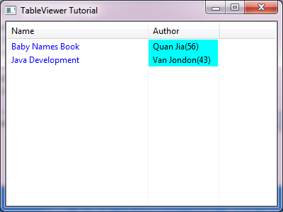
Table Viewer
ViewerFilter
viewer.addFilter(new ViewerFilter() {
public boolean select(Viewer viewer, Object parentElement,
Object element) {
if (element instanceof Book) {
Author author = ((Book) element).getAuthor();
if (author != null && author.getAge() < 40) {
return false;
}
}
return true;
}
});

Slide 24
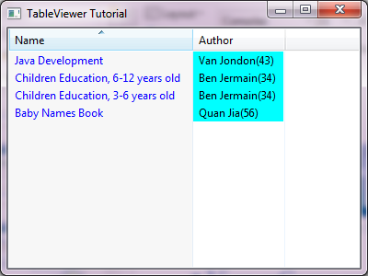
Table Viewer
ViewerComparator
viewer.getTable().setSortColumn(nameColumn.getColumn());
nameColumn.getColumn().addSelectionListener(new SelectionAdapter() {
public void widgetSelected(SelectionEvent e) {
viewer.setComparator(new ViewerComparator() {
public int compare(Viewer viewer, Object e1, Object e2) {
String n1 = ((Book) e1).getName();
String n2 = ((Book) e2).getName();
int value = Collator.getInstance().compare(n1, n2);
int sort = ((TableViewer) viewer).getTable()
.getSortDirection();
if ((sort & SWT.DOWN) != 0) {
return -value;
} else if ((sort & SWT.UP) != 0) {
return value;
}
return 0;
}
});
int sort = viewer.getTable().getSortDirection();
viewer.getTable().setSortDirection(
(SWT.UP & sort) != 0 ? SWT.DOWN : SWT.UP);
}
});

Slide 25
Table Viewer
Virtual Table & ILazyContentProvider
TableViewer viewer = new TableViewer(shell, SWT.VIRTUAL);
viewer.setContentProvider(new LazyContentProvider());
viewer.setLabelProvider(new LabelProvider());
String[] inputs = new String[100000];
for (int i = 0; i < inputs.length; i++) {
inputs[i] = "Value " + i;
}
viewer.setItemCount(inputs.length);
viewer.setUseHashlookup(true);
viewer.setInput(inputs);
private static class LazyContentProvider implements ILazyContentProvider {
private TableViewer viewer;
private String[] elements;
public void dispose() {
}
public void inputChanged(Viewer viewer, Object oldInput, Object newInput) {
this.viewer = (TableViewer) viewer;
elements = (String[]) newInput;
}
public void updateElement(int index) {
viewer.replace(elements[index], index);
}
}

Slide 26
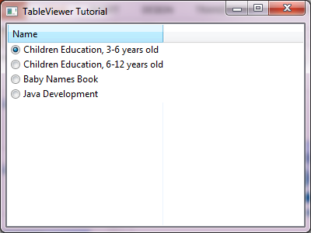
Table Viewer
TableEditor
nameColumn.setLabelProvider(new CellLabelProvider() {
public void update(ViewerCell cell) {
TableItem item = (TableItem) cell.getItem();
if (item.getData("EDITOR") != null) {
TableEditor editor = (TableEditor) item.getData("EDITOR");
editor.getEditor().dispose();
editor.dispose();
}
TableEditor editor = new TableEditor(item.getParent());
Composite control = new Composite(item.getParent(), SWT.NONE);
control.setBackground(item.getParent().getBackground());
control.setBackgroundMode(SWT.INHERIT_DEFAULT);
RowLayout layout = new RowLayout(SWT.HORIZONTAL);
control.setLayout(layout);
Button button = new Button(control, SWT.RADIO);
button.setText(((Book) cell.getElement()).getName());
editor.grabHorizontal = true;
editor.setEditor(control, item, 0);
item.setData("EDITOR", editor);
}
});

Slide 27
TreeViewer
Initialize
Default
With Tree control
TreeViewer viewer1 = new TreeViewer(parent);
TreeViewer viewer2 = new TreeViewer(parent, SWT.FULL_SELECTION|SWT.BORDER);
Tree tree = new Tree(parent, SWT.FULL_SELECTION|SWT.BORDER);
TreeViewer viewer3 = new TreeViewer(tree);

Slide 28
TreeViewer
Content Provider
ITreeContentProvider
public Object[] getChildren(Object parentElement) {
if (parentElement instanceof Library) {
Set<Author> authors = authorMap.get(parentElement);
if (authors == null) {
authors = new HashSet<Author>();
List<Book> books = ((Library) parentElement).getBooks();
for (Book book : books) {
Author author = book.getAuthor();
if (author == null) {
continue;
}
authors.add(author);
}
authorMap.put((Library) parentElement, authors);
}
return authors.toArray();
} else if (parentElement instanceof Author) {
return ((Author) parentElement).getBooks().toArray();
}
return new Object[0];
}
public Object[] getElements(Object inputElement) {
if (inputElement instanceof List<?>) {
return ((List<?>) inputElement).toArray();
}
return new Object[0];
}
public Object getParent(Object element) {
if (element instanceof Book) {
return ((Book) element).getAuthor();
}
return null;
}
public boolean hasChildren(Object element) {
return getChildren(element).length != 0;
}

Slide 29
Tree Viewer
Expand and Collapse
setAutoExpandLevel (int level) // 0, 1 … ALL_LEVELS
setExpandedElements(Object[] elements)
setExpandedState(Object elementOrTreePath, boolean expanded)
setExpandedTreePaths(TreePath[] treePaths)
setExpandPreCheckFilters(boolean checkFilters)
expandAll()
collapseAll()

Slide 30
TreeViewer
TreePath
ITreePathContentProvider
ITreePathLabelProvider

Slide 31
TreeViewer
Virtual Tree
ILazyTreeContentProvider
ILazyTreePathContentProvider

Slide 32
Column Viewer
ColumnViewerEditorActivationStrategy
FocusCellHighlighter
FocusCellOwnerDrawHighlighter
ColumnViewerToolTipSupport

Slide 33
Any Questions?
Skype: jin.liu.soyatec
Email: jin.liu@soyatec.com

Slide 34
The end

